Slide 1
CS6382 Algorithm Analysis and Game Theory:
Review of Classic Algorithms

Slide 2
Outlines
Enumeration 枚举
Simplest method
How to reduce the instances you have to enumerate?
Greedy
Every time pick the current “best” choice
How to define best?
How to prove that optimal solution can be obtained in this way?
Dynamic Programming
How to design states
Divide and Conquer

Slide 3
Example 1
Coin Flipping
There are N (N<10000) rows of coins
Each row consists of 9 coins
They formulate a matrix of size N*9
Some coins are heads up and some are tails up
We can flip a whole row or a whole column every time
Find a flipping method that can make the number of “heads up” coins maximum

Slide 4
Example 2
Discrete Function
A discrete function is defined on {1,2,3,…,N}
Function values are between 2⁻³² and 2³²
Find two points on the function curve such that
Any function point between these two points are below the line connecting these two points
The slope of the line connecting these two points are as large as possible
O(n³) → O(n²)
O(n²) → O(n)
So?是类似y=x³,取x=0和x=3这样的下凸函数？

Slide 5
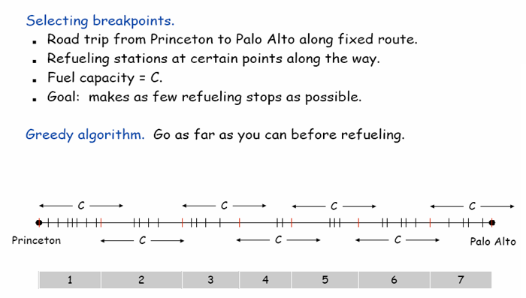
Greedy Review
So怎么不是1-5都是最长like2一样，然后看需不需要7号？

Slide 6
Example 3 – Gone Fishing
There are n fishing lakes on a line
Labeled 1, 2, 3, …, n from left to right
H hours’ fishing time
Start from lake 1
5*T_{i} minutes to reach lake i+1 from lake i
At the same lake i
The first 5 minutes can produce F_{i} fishes
Every 5 minutes more will see a decrease of D_{i} in the number of fishes produced
How to get the maximum number of fishes?

Slide 7
Example 4 – Enlightened Landscape
X₁
X₂
X₃
X₄
X₅
X₆

Slide 8
Review of Dynamic Programming
State space (table entry definition)
State Transition Function
Complexity=A*B*C
A: Number of states
B: Number of combinations (branches) in deciding the optimal for each state
C: Cost in calculating the value of each branch

Slide 9
Dynamic Programming Approach
Top-Down Approach (Memoizing)
Like the recursive algorithm
Look up the table before computing the solution
Bottom-Up Approach
Usually more efficient

Slide 10
Example1 LCS
Longest Common Sub-sequence
Given 2 character sequences (A, B)
Sub-sequence
Pattern of characters in A appears in B
Many possible solutions
Some of the solutions are the optimal
Answer: the maximum length
Answer: the optimal sub-sequence(s)
Seq_A = CAGT TACGC AGGT A
Sub_Seq = CA T CGC A A
Seq_B = CA TG CGCTA TAA

Slide 11
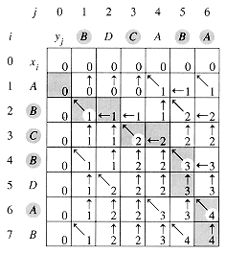
Longest Common Sub-sequence
BCBA

Slide 12
Longest Common Sub-sequence
Initialize to Zeros
First Iteration
•
•
•
•
•
•
Optimal Solution

Slide 13
Example 2—Dance Dance Revolution
Mr. White is very fat but like DDR so much
He’d like to use least energy to correctly follow a melody
Rules:
When a new symbol comes, he should move one of the feet to that symbol while keeping the other in the original place
How to calculate energy?
Moving cost:
Adjacent move: 3
Opposite move: 4
Center to any: 2
Tap the same position: 1

Slide 14
How to choose suitable states?
Enough to use d[i] where i is the index for the steps?
We should choose d[i, j, k] where j and k represents the positions of left foot and right foot respectively
Criteria
Future decisions only depend on the current state

Slide 15
Tree Model (Example 3)
Finding Maximum Comfortable Group on Tree
Input: a tree
Output: a comfortable group of maximum size
What is comfortable group?
A set of nodes with no edge between any pair
How to define state (subproblem)?

Slide 16
Example 4
Minimize longest path in a tree
Greedy Version
DP version
Shorter time DP

Slide 17
Review of Divide and Conquer
Break a big problem into smaller problems and then combine the solution in a certain way
Running time analysis relies heavily on recursive relations

Slide 18
Example: Selection Problem
Problem: given a group of N numbers, determine the k^{th} largest, where N > k.
Solution 1:
read N number into an array,
sort the array in descending order,
return the element in position k.

Slide 19
Example: Selection Problem
Solution 2:
read the first k elements into an array and sort them in descending order,
each remaining element is read one by one,
2.1) it is ignored if it is smaller than or equal to the k^{th} element in the array
2.2) otherwise, it is placed in its correct spot in the array, bumping one element out of the array.
the element in the k^{th} position is returned as the answer.
This process is similar to a slow process of external sorting

Slide 20
Example: Selection Problem
Solution 3:
Warmup: Partition algorithm in Quicksort
What is the connection?
If p = k, return A[k].
If p > k, recursively select element k from the elements before the pivot.
If p < k, recursively select element (k – p – 1) from the elements after the pivot.
Worst case O(n^2)

Slide 21
Example: Selection Problem
How to find a better pivot?
Median of the first 2/3 numbers
T(n)<=2T(2n/3)+O(n)→O(n^(log2/log(3/2)))→O(n^1.7)
An even better pivot?
Divide the numbers into groups of 5
Find the Median of every group
Find the Median of all the n/5 medians T(n/5)
Guarantees 30%/70% split T(7n/10)
T(n)<=T(n/5)+T(7n/10)+O(n) →T(n)=O(n)
Proof: Guessing T(n)<=kn (substitution method)

Slide 22
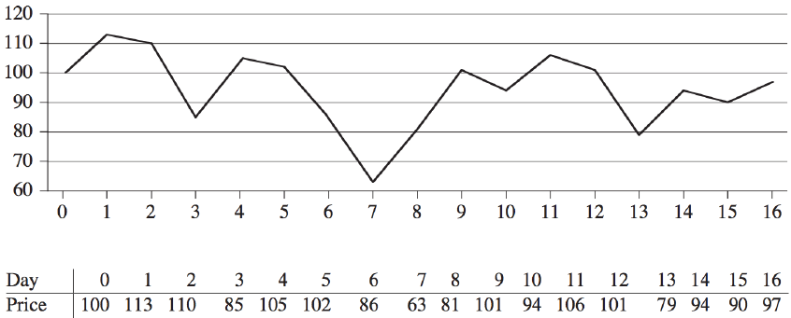
Maximum-subarray problem
Consider to buy a stock given the prediction curve - buy low and sell high
Notes:
A prediction curve

Slide 23
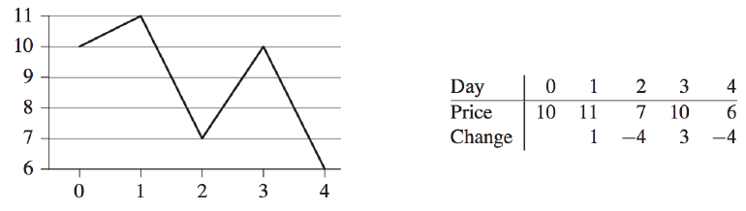
Maximum-subarray problem
First: choose highest price and go left to find the lowest price
Second: choose lowest price and go right to find the highest price
Optimal solution: neither of them
Notes:
The best solution: the second lowest to the second highest

Slide 24
A brute force solution
Try every possible pair of buy and sell dates
Question: what is the running time of this algorithm for n dates?
Can we do better? Answer is YES!

Slide 25
A transformation
Find a sequence of days over which the net change is maximum
Find the nonempty, contiguous subarray of A whose values have the largest sum
Call this contiguous subarray the maximum subarray
Notes:
Instead of looking at the daily prices, let us instead consider the
daily change in price and form a new array A

Slide 26
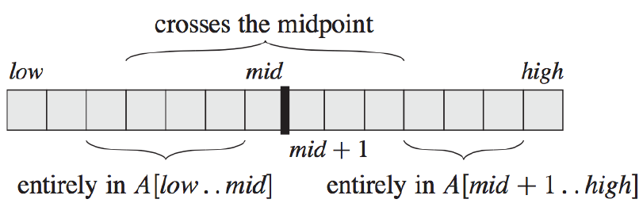
A divide-and-conquer solution
Suppose we want to find a maximum subarray of A[low,…,high]
The middle point, mid=(low+high)/2
Suppose A[i,…,j] is the maximum subarray of A[low,…,high]
Three situations:
A[i,…,j] in A[i,…,mid]
A[i,…,j] in A[mid+1,…,j]
A[i,…,j] cross mid

Slide 27
A divide-and-conquer solution
Solve the subarrays A[low,…,mid] and A[mid+1,…,high] (two sub-problems) recursively
Then the third case low<=i<=mid<j<=high
Then take the largest of these three
How to solve the third case?
Seems not a sub-problem
But the added restriction – crossing the midpoint - helps

Slide 28
A divide-and-conquer solution
Any subarray crossing the midpoint is itself made of two subarrays A[i,…,mid] and A[mid+1,…,j]
The restriction fixes one ending point for the first array and one starting point for the second array
Therefore, we just need to find maximum subarrays of the form A[i,…,mid] and A[mid+1,…,j] and then combine them – which is easy to solve!

Slide 29
From Divide and Conquer to …
Running time Analysis
T(n)=2T(n/2)+O(n)→T(n)=O(nlogn) by Michael Shamos
Then in a seminar given by Michael Shamos in CMU, Jay Kadane came up with a solution in one minute…
Kadane’s algorithm (Dynamic Programming):
Keep the best sum up to j and best sum from 1 to j
Update from j to j+1 (The largest of the three below)
k to j+1
k to j
best sum from 1 to j

Slide 30
Just the beginning
These methods will be used in later topics
You may see the same approach recur in later topics
Thinking actively is very important in the 3-hour session

